Slide 1

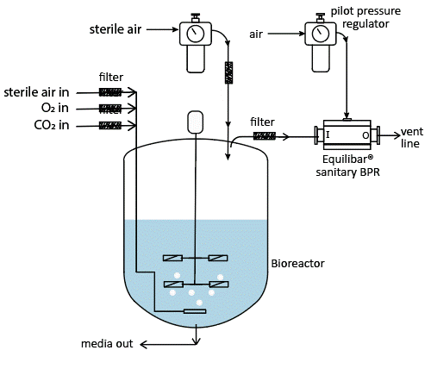
Bioreactor Team Proposal - Context
Project Challenge: Design a connected bioreactor control system that maintains critical parameters within specification. BCG production in low-resource settings relies heavily on precise bioreactor control, even small parameter deviations can compromise vaccine efficacy and waste critical resources.
Equilibar, 2025
Control Specifications:
Temperature: 25-35°C (±0.5°C tolerance)
Stirring: 500-1500 RPM (±20 tolerance)
pH: 3-7 range (optimal ~5 for vaccine cultures)
Success Metric:
Demonstrate stable operation within specification tolerances over extended test periods, with remote parameter adjustment with automated anomaly detection.
Industrial-scale bioreactors require sophisticated control systems. Our small-scale testbed replicates the core challenges using low-cost, low-power microcontrollers and sensors to achieve comparable precision

Slide 2
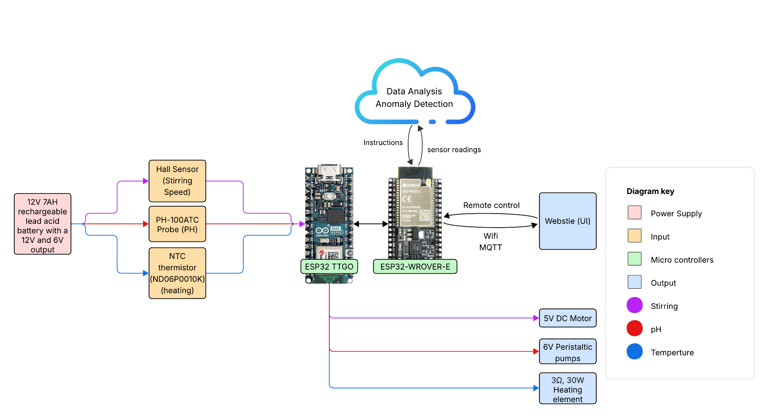
Overall Diagram
Notes:
https://lucid.app/lucidchart/54f00117-e9ec-4e4e-b3e8-fe2c9ddb3385/edit?viewport_loc=-507%2C-135%2C3607%2C1778%2C0_0&invitationId=inv_1e61fa32-f2b5-470f-897b-0d43d9cc37e0
For editing the diagram

Slide 3
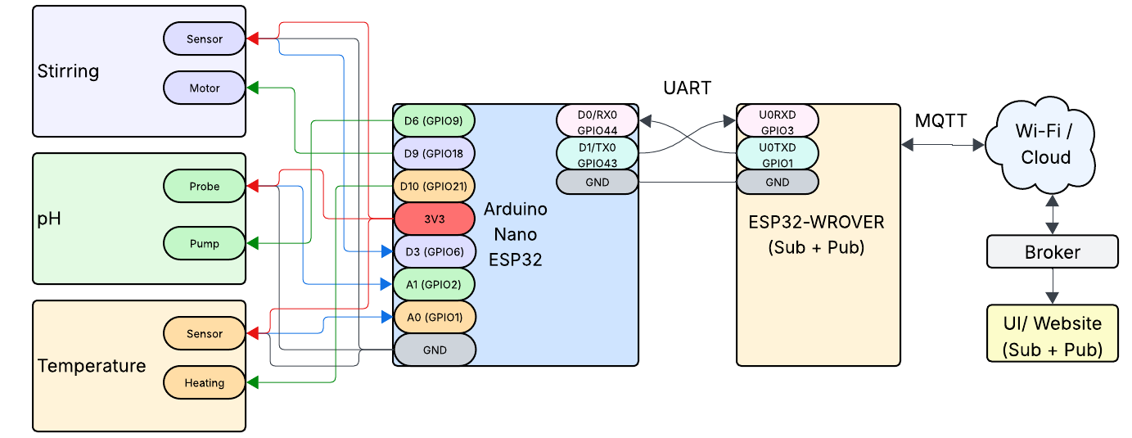
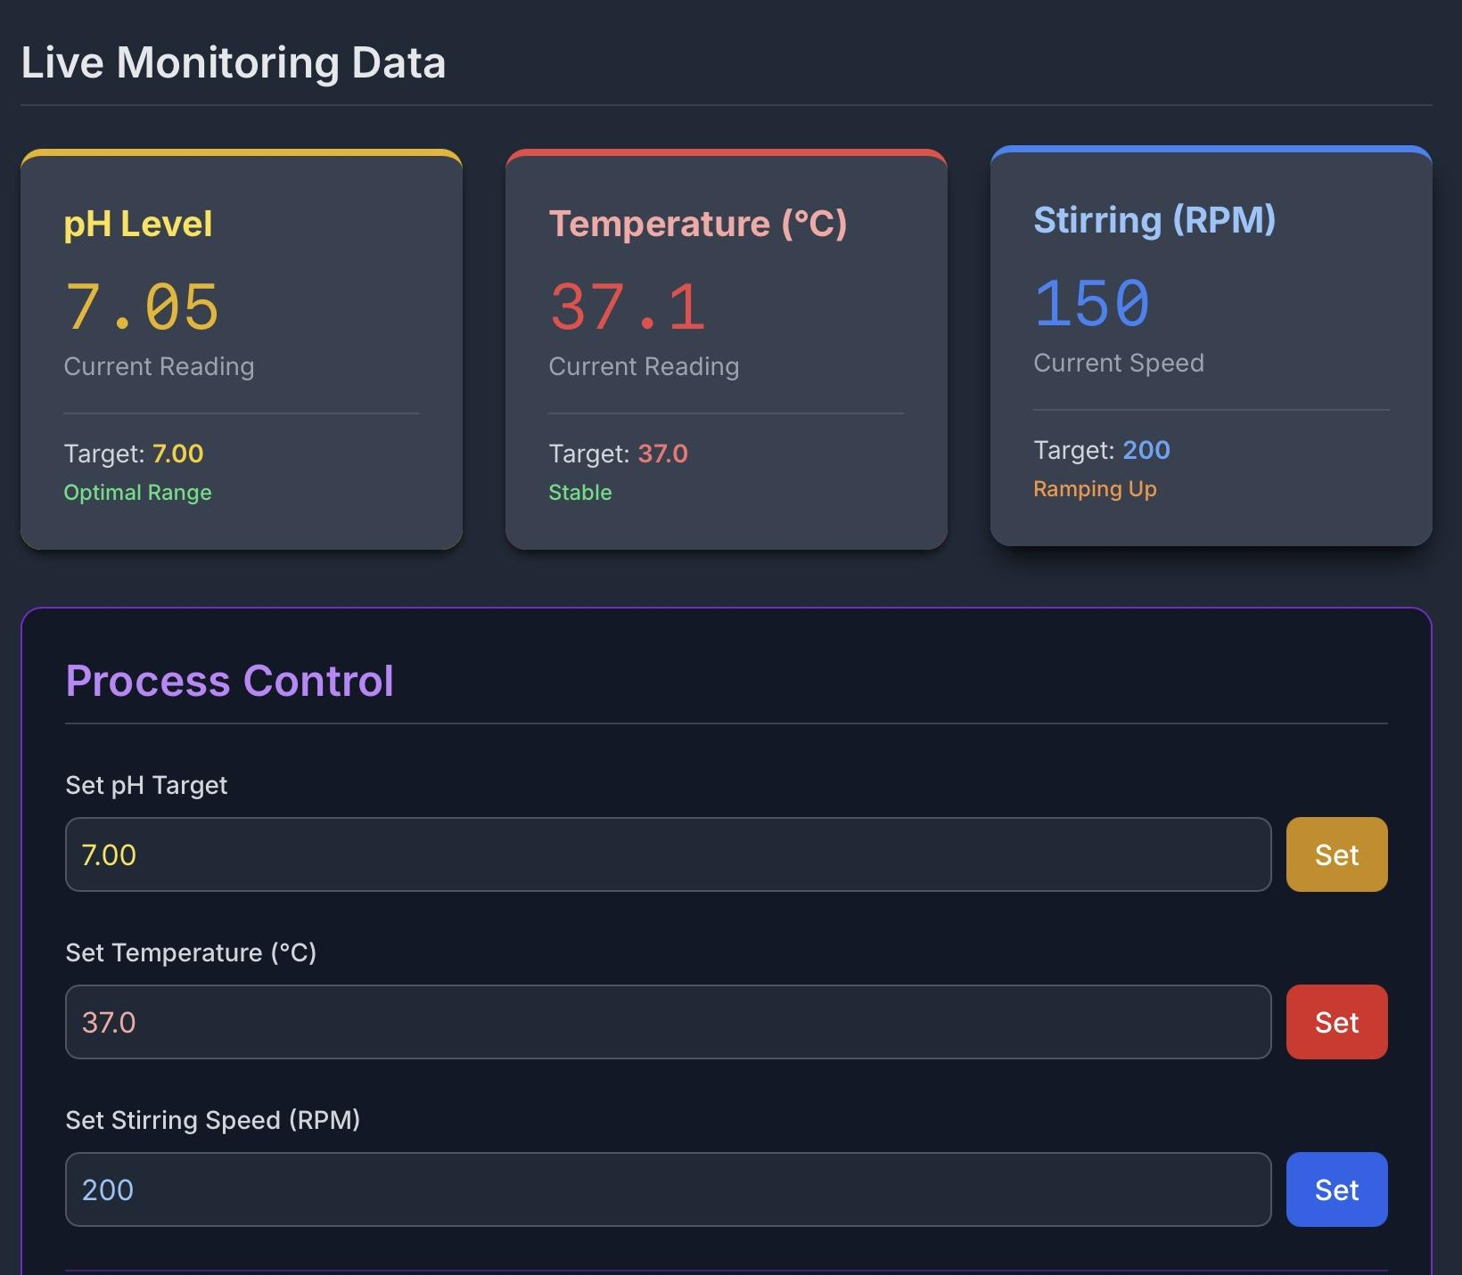
Connectivity and UI
Protocols used:
Serial connection:
UART (Universal Asynchronous Receiver Transmitter)
Connection to Wifi and UI:
MQTT (Message Queuing Telemetry Transport)
Using Wi-Fi, data from the microcontroller can be accessed via a web interface that:
Displays live and historical data through interactive graphs.
Allows users to adjust motor and pump settings remotely.
Detects and alerts users to system anomalies in real time.
UI example

Slide 4
Data Analysis
Sensors
Bioreactor Control
Cloud
Real-time data readings
Confirm Anomaly
Provide instructions
Compare with target values
|⍙| > cutoff
stop bound
Yes
Yes
Counter ≥ 3
Yes
No
No
Previous anomaly?
Counter +1
No
|⍙| > cutoff
start bound
Yes
Normal
Counter reset to 0
No

Slide 5
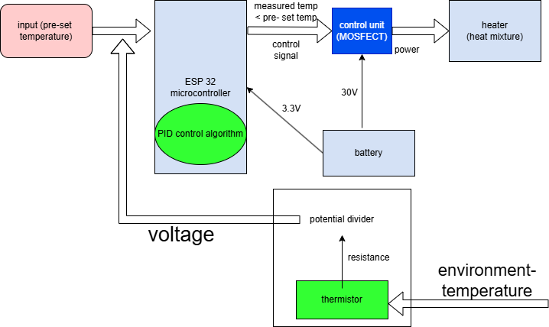
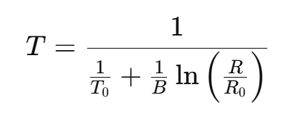
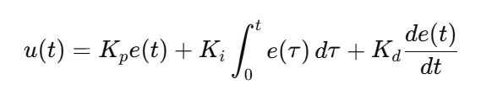
Heating Subsystem
The measurement of temperature is based on measuring resistance of the thermistor.
For the calculation of temperature, a reference temperature is required.

Slide 6
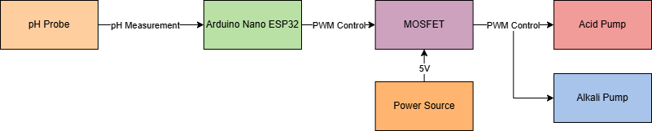
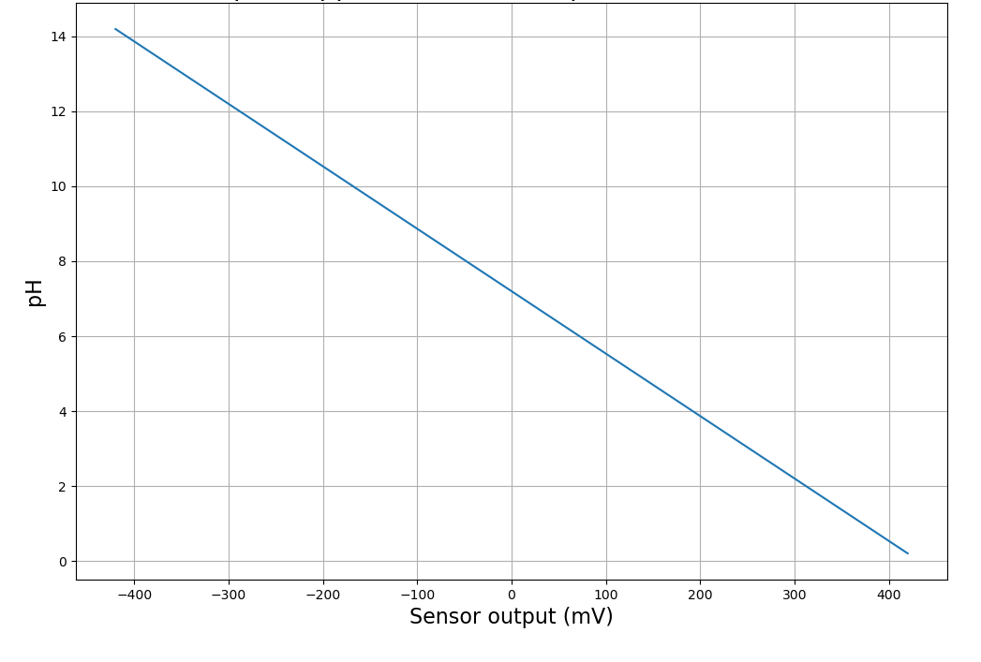
pH Subsystem
pH Calibration:
Voltage Equation:
pH = m x Voltage + b
where:
m = (pH1-pH2) / (V1-V2)
b = pH1 - m x V1
Glass pH probe (PH-100ATC), ±0.05 pH accuracy after calibration.
pH and pump actions logged every 5s to ESP32/Server with timestamps for monitoring.
pH Control
To keep the pH value as close to the biologically optimal target value we use a PID (Proportional-Integral-Derivative) control algorithm, with a deadband of ±0.2 pH units to prevent oscillation. This allows stability within ±0.2 pH of the target value (approximately 5.5pH for optimal microbial growth) and prevents frequent pump switching.

Slide 7
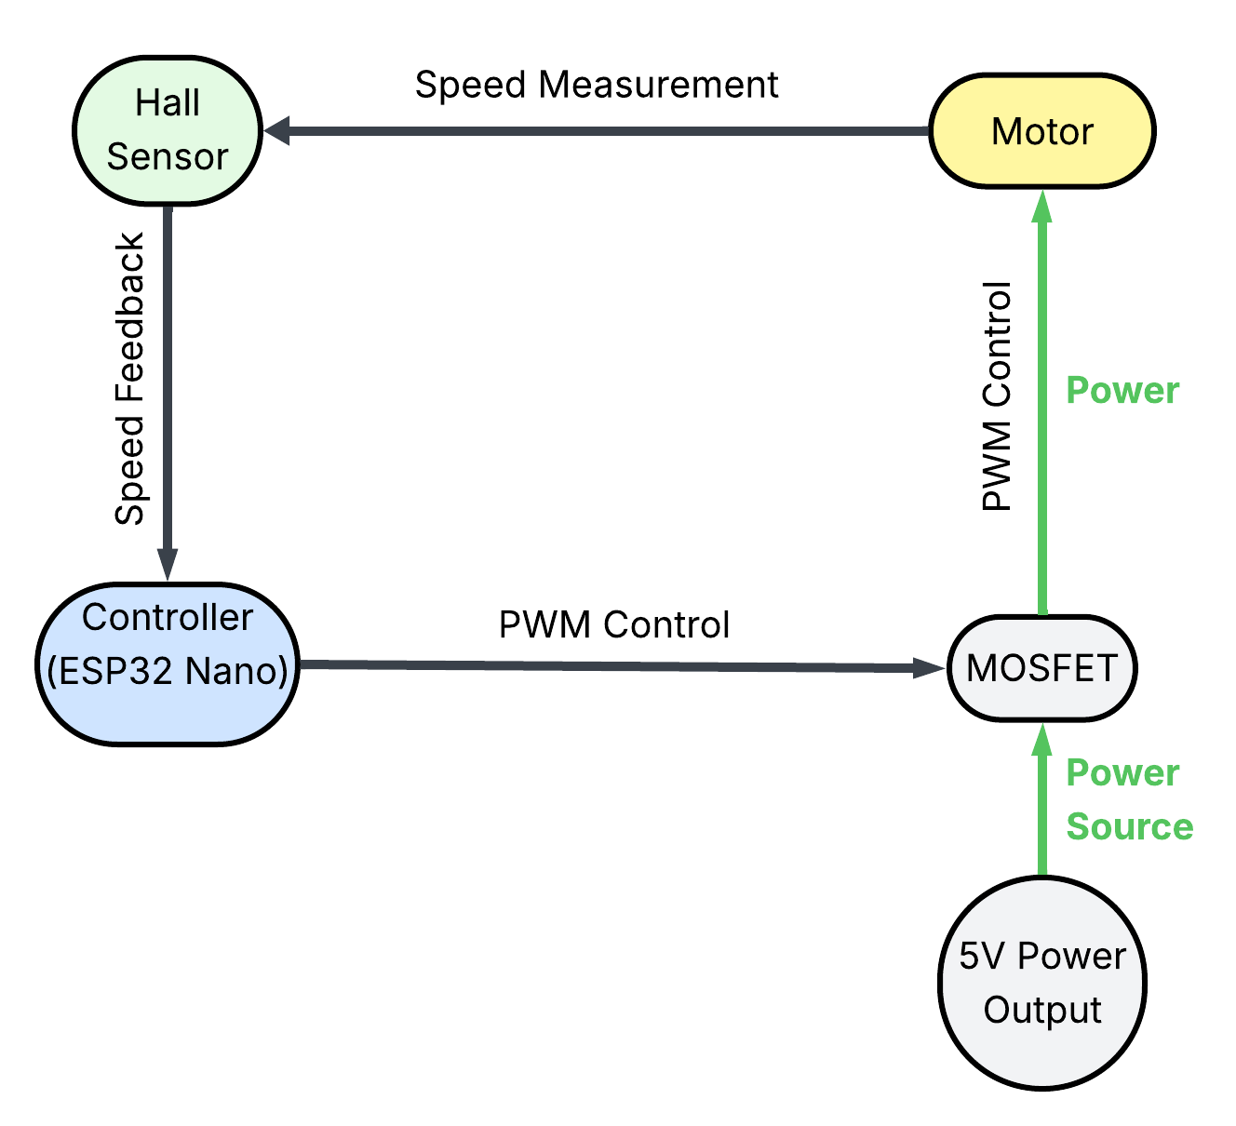
Stirring Subsystem
Material List:
Controller ESP32 Nano*
Motor & Stirring Up to 10,000 RPM, 10:1 gear ratio for effective stirring
MOSFET >>1A for PWM management between 0-5V, e.g. with a PI controller
Hall Sensor 70 pulses per revolution, 1000 RPM -> 1167 pulses/s
5V Power Supply
Additional Materials:
Cabling (reasonably short)
Capacitor 470 uF
Flyback diode
*Controller will record RPM information regularly and transmit that for data logging, monitoring and analysis

